Slide 1
Short Pairing-Free Blind Signatures with Exponential Security
Stefano Tessaro, Chenzhi Zhu
University of Washington

Slide 2
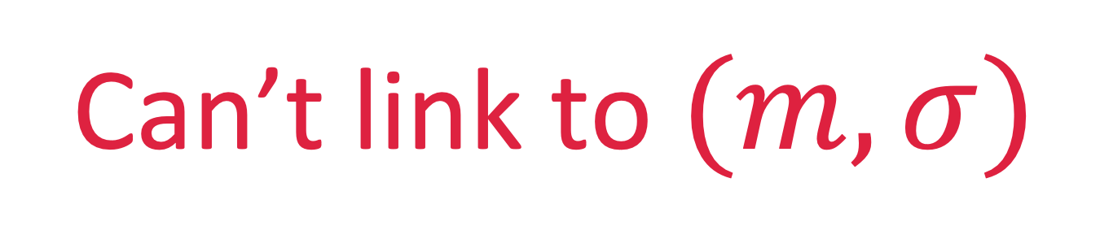
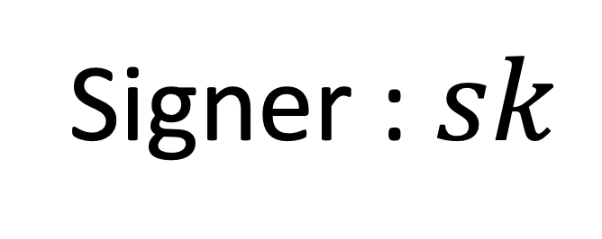
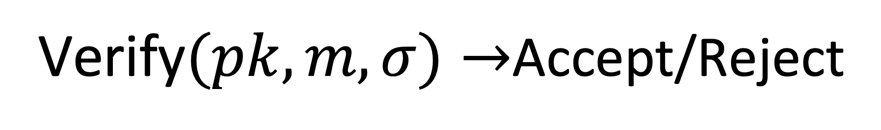
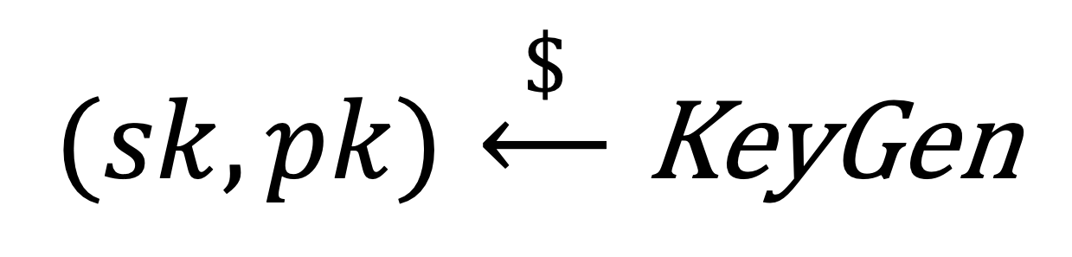
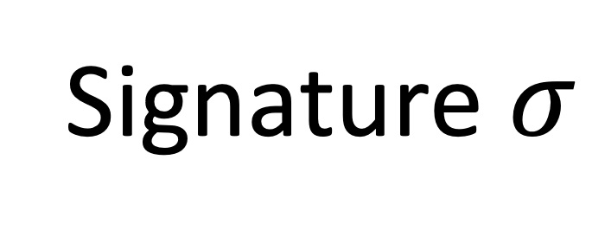
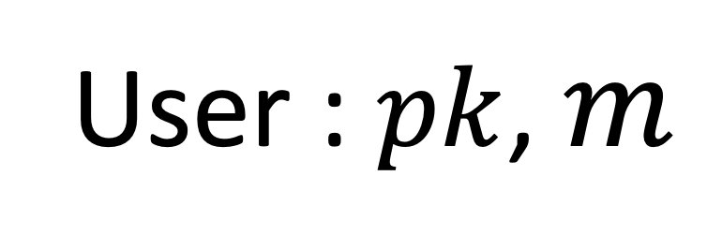
Blind Signature
$$(sk,pk)\overset{\$}{⟵}\text{KeyGen}$$
Signer : $sk$
User : $pk$, $m$
Blind
Signature $σ$
Can’t link to $(m,σ)$
Verify$(pk,m,σ)→$Accept/Reject
Notes:
I will start with what is blind signature. In the context of Blind signature, there are a signer with secret key and a user with pk.
User wants to sign a message m by running an interactive protocol with the signer. At the end the user will learn a valid signature for m, which can be verified using the public key.
On the other side, we require the signer to be blind, which means the signer does not know the message during signing, and moreover, even given the message and the signature later, the signer cannot link them back to which session that issues them.

Slide 3
Applications of Blind Signatures
Anonymous e-cash systems [Chaum83]
Anonymous credentials (e.g., [CL04])
Anonymous tokens in web applications:
e.g. Privacy-preserving ad-click measurement
Notes:
Blind signatures have a number of well-known applications.
For example, they have been used in anonymous e-cash systems and within anonymous credentials. And recently, they have regained popularity due to their ability to implement anonymous tokens in some applications. for example, for privacy-preserving ad-click measurement.

Slide 4
Practically Efficient Schemes
RSA-based:
Blind RSA [Chaum83]
Schnorr-style: Blind Schnorr [CP93],
[Oka93], [HKL19]
Pairing-based: Blind BLS [BLS01]
SPS-EQ [HS14, …]
2-round
3-round
2-round
Large key sizes
Standard elliptic curves
Pairing-friendly elliptic curves
Subject to ROS attack [BLL+21]
Can we have a secure Schnorr-style scheme which is also very efficient?
Notes:
The current practically efficient schemes fall into one of the following three classes: RSA-based schemes, Schnorr-style schemes, and Pairing-based schemes.
Schnorr-style schemes require 3 rounds for each signing, while RSA and pairing based schemes only require 2 rounds. However, both RSA and pairing based schemes have some drawbacks.
The main drawback of pairing-based schemes is that they require a pairing-friendly elliptic curve, which makes them undesirable for many applications, due to the lack of high assurance implementations, for example, in internet browser.
On the other hand, RSA blind signatures inherit all undesirable properties of RSAs, like large key sizes.
Therefore, many applications might prefer using Schnorr-style schemes despite their higher round complexity, in particular, because they are simple to implement, allow efficient verification, and can be based on any standard elliptic curve.
However, very recently, Benhamounda et al. showed a polynomial time attack against the most efficient Schnorr-style schemes based on efficiently solving the ROS problem.
Therefore, a big problem which we address in this paper is whether we can …?
Of course, we are not the first to ask this question, so let me first tell you a little more about related works.

Slide 5
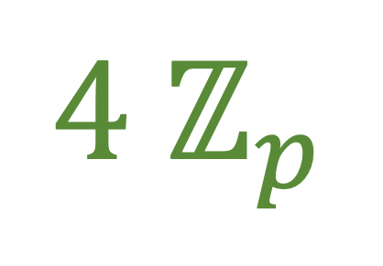
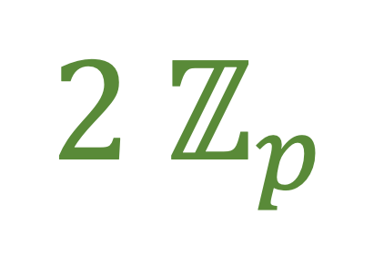
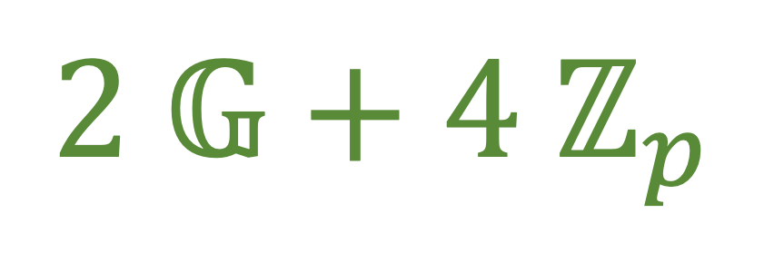
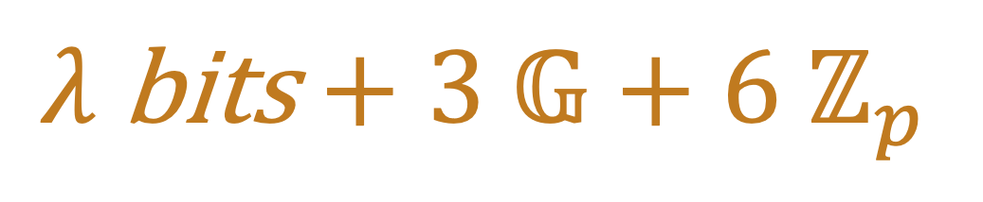
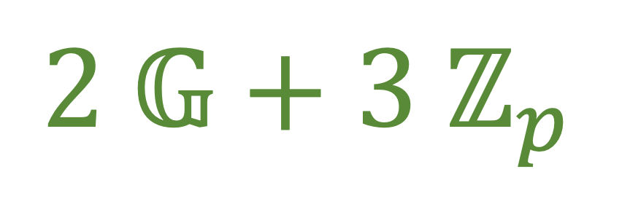
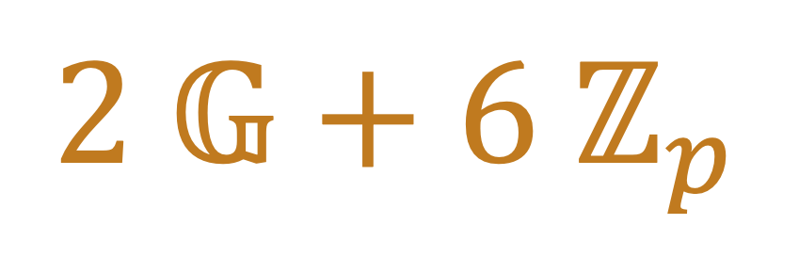
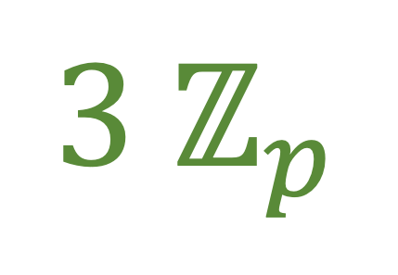
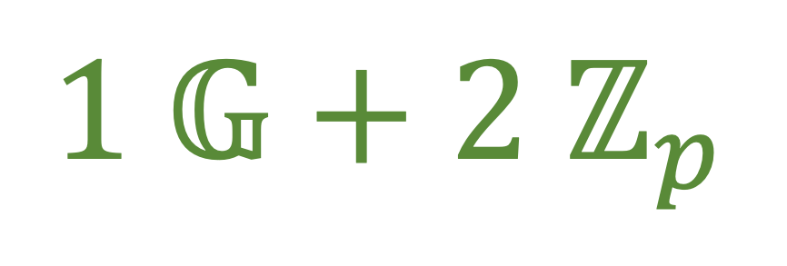
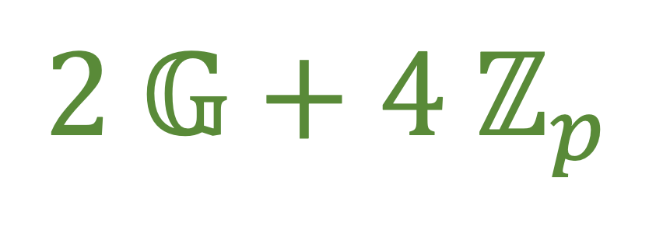
Previous Results & Our Results
Assuming AGM and ROM
Signature Size
Communication
Security
Blind Schnorr [CP93]
$$2{ ℤ}_{p}$$
$$1 𝔾+2{ ℤ}_{p}$$
Subject to ROS attack
[Abe01]
$$2 𝔾+6 ℤ_{p}$$
$$λ \text{bits}+3 𝔾+6{ ℤ}_{p}$$
DDH [KLRX22]
Clause Blind Schnorr
[FPS20]
$$2 ℤ_{p}$$
$$2 𝔾+4 ℤ_{p}$$
OMDL + mROS
Best pairing-free schemes so far with exponential security!
sub-exponential attack
Our Schemes:
Scheme 1
$$3 ℤ_{p}$$
$$2 𝔾+3{ ℤ}_{p}$$
GGM
Scheme 2
$$4 ℤ_{p}$$
$$2 𝔾+4 ℤ_{p}$$
DL
Partially blind version
Notes:
The original Blind Schnorr scheme proposed by Chaum and Pedersen is the most efficient. The signature size is just 2 scalars and the communication complexity is 1 group element and 2 scalar per signing. However, as I mentioned before, the scheme is actually broken.
An alternative is a scheme proposed by Abe in 2001. However, it is less efficient and its original proof was found to be incorrect. But a recent result by Kastner et al., shows its security in the algebraic group model and the random oracle model. At this point I will point out, all the results I discuss from now on in this slide assume these two ideal models.
A more efficient scheme was proposed by Fuchbuoer et al in 2020, which is referred to as Clause Blind Schnorr. The signature size is the same as Blind Schnorr with doubled communication complexity. However its security relies on a new assumption, namely the so-called mROS problem is hard, where mROS is a variant of ROS proposed in their paper.
An important point here is that there exists a sub-exponential attack against mROS which requires choosing large elliptic curves to achieve desired security level.
As you can see, the existing schemes are either not very efficient or do not have best possible security guarantees. So the main contribution of this work is that we proposed two schemes that are both efficient and have exponential security.
For our first scheme, the signature size is just 3 scalars and their communication complexity is 2 group elements and 3 scalars per signing; we prove its security in the generic group model.
Our second scheme can be proved secure in the algebraic group model just assuming that the discrete log is hard in addition to a random oracle. However, we need to add an additional scalar to both the communication and the signature size.
A very appealing feature of this second scheme is that it admits a partially blind version, where partially blind means it allows a part of the message to be known to the signer, which is a useful property in several applications.
As you can see, our schemes are the most efficient pairing-free schemes so far with exponential security!

Slide 6
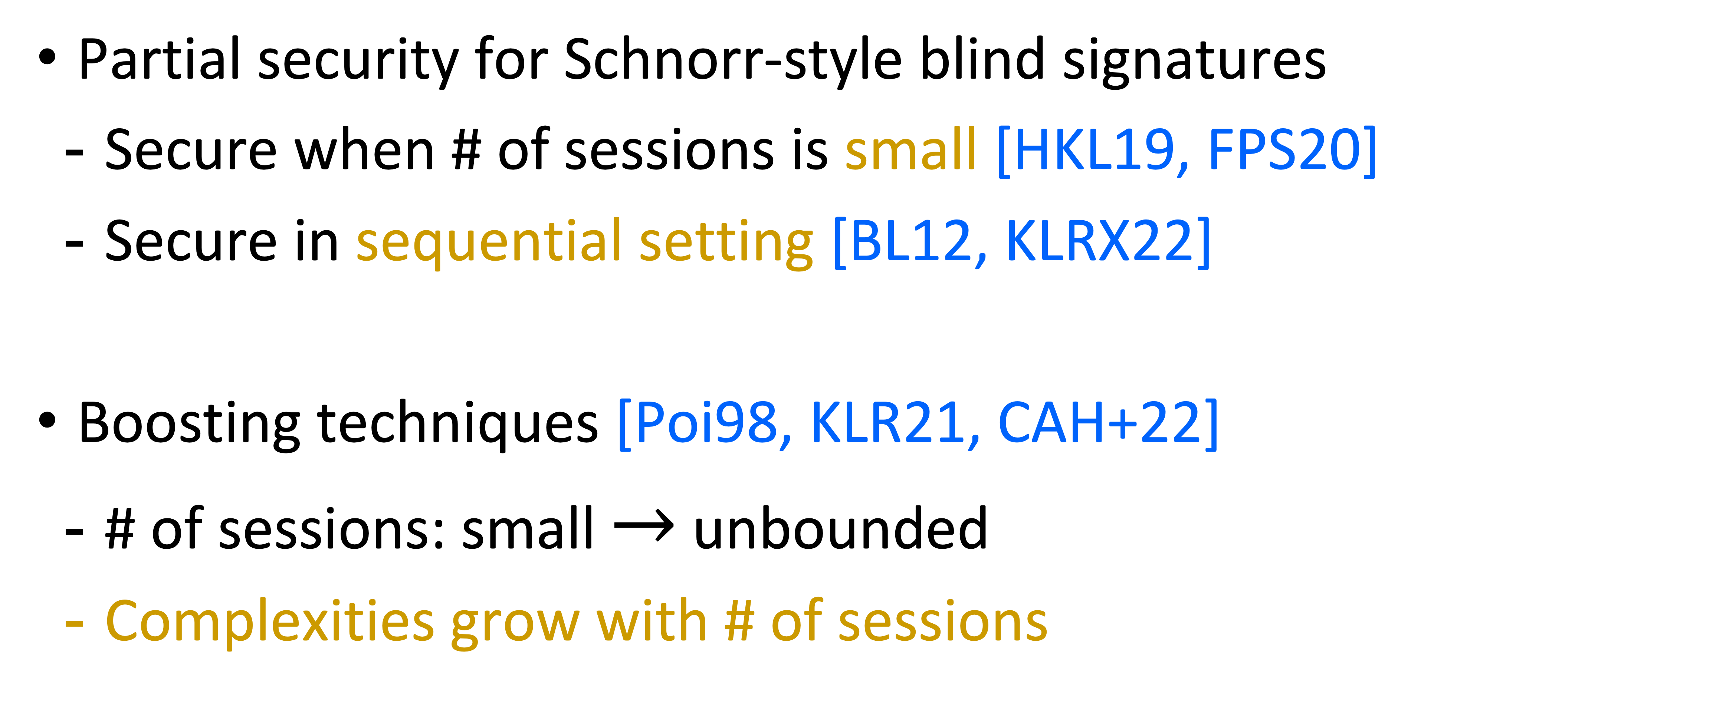
More on Previous Results
Partial security for Schnorr-style blind signatures
Secure when # of sessions is small [HKL19, FPS20]
Secure in sequential setting [BL12, KLRX22]
Boosting techniques [Poi98, KLR21, CAH+22]
# of sessions: small $→$ unbounded
Complexities grow with # of sessions
Sequential setting
S
U
Notes:
Before we more on, I would like to mention a few more related works to give you a full picture of the area.
First of all, there were security analyses of Schnorr-style schemes in some restricted settings.
For example, some of them can be shown secure when the # of signing sessions is small or when these signing sessions are sequential. In this work, however, we target the more realistic setting, where the sessions are concurrent and their number is unbounded.
Interestingly, some of these works I listed here do not assume AGM or GGM.
Another interesting line of works explores boosting techniques, where the goal is to transform a scheme that is secure only for a small number of sessions into a scheme that is secure for an unbounded number of sessions. However, one drawback of the resulting schemes is that their communication and computation complexities grow with the # of sessions.

Slide 7
Blind Signature
$$(sk,pk)\overset{\$}{⟵}\text{KeyGen}$$
Signer : $sk$
User : $pk$, $m$
Blind
Signature $σ$
Verify$(pk,m,σ)→$Accept/Reject

Slide 8
Unforgeability
$$(sk,pk)\overset{\$}{⟵}\text{KeyGen}$$
Signer : $sk$
Adversary
Blind
Notes:
I will now come to the technical part of the talk.
I will not define blindness formally. “We will rely on an intuitive understanding.” In this talk, I will mostly discuss how to achieve unforgeability. However unlike a normal signature scheme, where unforgeability is defined as the adversary cannot forge a signature that has not been issued by the signer, for blind signatures, it is unclear which signatures are issued by the signer. Therefore, we need to use another notion called one-more unforgeability.

Slide 9
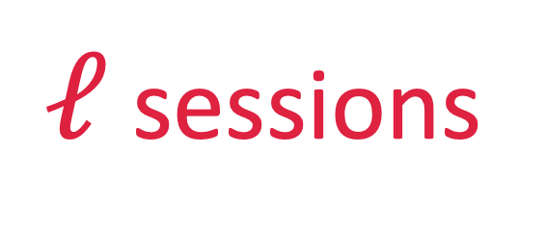
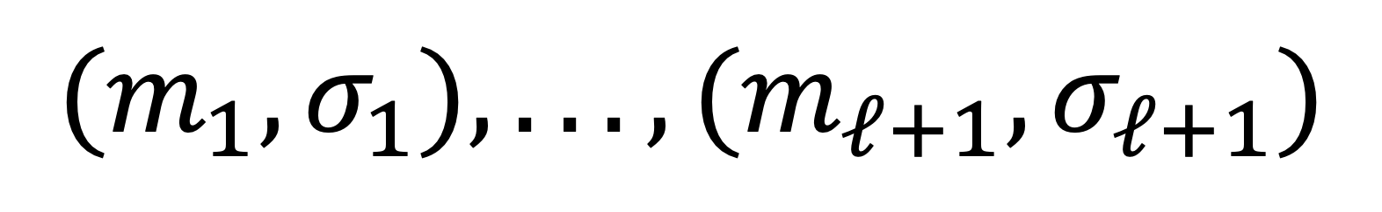
One-More Unforgeability (OMUF)
$$(sk,pk)\overset{\$}{⟵}\text{KeyGen}$$
*Can be arbitrarily concurrent
Signer : $sk$
Adversary
Blind
Concurrent setting
$ℓ$ sessions
S
U
$$(m_{1},σ_{1}),...,(m_{ℓ+1},σ_{ℓ+1})$$
Notes:
In the security game, the adversary interacts with the signer for \ell signing sessions. Then, the adversary succeeds if it can output \ell+1 different message-signature pairs. Here the ell sessions can be arbitrarily concurrent.
In other words, OMUF means that the adversary cannot generate a number of signatures which is larger than the number of sessions.

Slide 10
Overview
1.
Blind Schnorr
ROS problem
*Solvable in polynomial time [BLL+21]
2.
3.
Our schemes
GGM or AGM + DL
WFROS problem
*Exponential hardness
Notes:
The overview of the rest of my talk is as follows.
To give you some intuition about our constructions, I will first recall what Blind Schnorr signatures are and explain their relation with the ROS problem. More precisely, I will show how one can break OMUF of blind Schnorr by solving the corresponding ROS problem. Since the ROS problem is solvable in polynomial time, this gives a polynomial time attack aginst Blind Schnorr.
Next, I will explain our idea to avoid the ROS attack that underlies our constructions.
Under some assumptions, the security of our schemes is equivalent to solving the WFROS problem, which is a new problem we define. In contrast to ROS, we show that WFROS is exponentially hard, which implies the exponential security of our schemes.
In particular, I will show how WFROS is define and give some intuition behind its hardness.

Slide 11
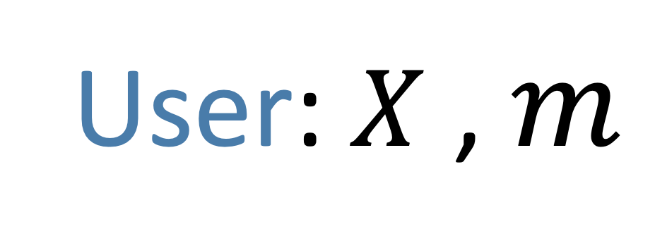
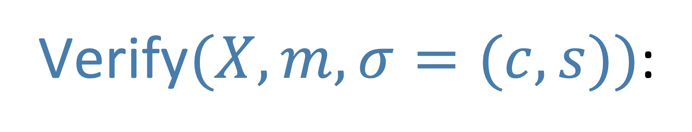




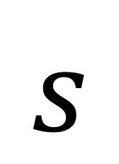
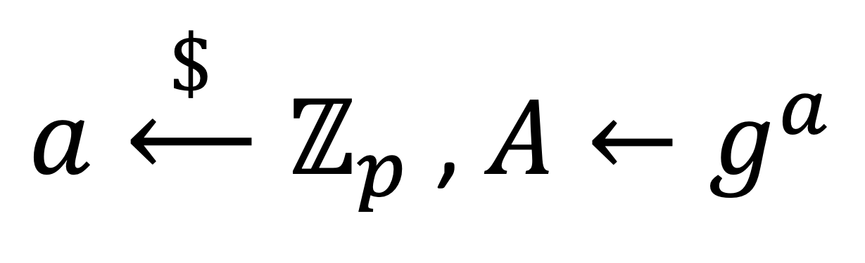

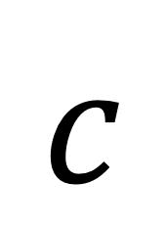
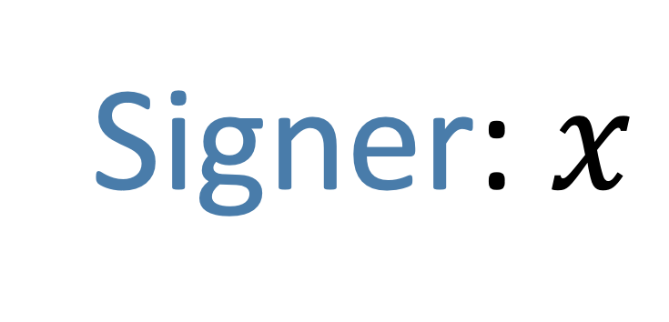
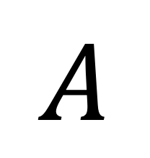
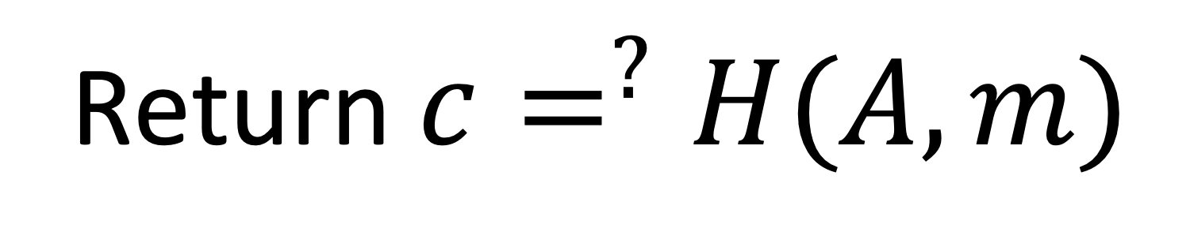
Blind Schnorr (non-blind)
$(𝔾,p,g)$ : $𝔾=⟨g⟩$, $|𝔾|=p$
$H$ : $\{0,1\}^{∗}$ $⟶$ $ℤ_{p}$
$sk$ : $x\overset{\$}{⟵}ℤ_{p}$ , $pk$ : $X←g^{x}$
Signer: $x$
User: $X$ , $m$
$$A$$
$a\overset{\$}{⟵}ℤ_{p}$ , $A←g^{a}$
$$c$$
$$c←H(A,m)$$
$$s←a+c⋅x$$
$$s$$
$$σ←(c,s)$$
Verify$(X,m,σ=(c,s))$:
$A←g^{s}X^{−c}$ ;
Return $c=^{?}H(A,m)$
Notes:
To start with, I will first describe the non-blind version of Blind Schnorr signatures.
The public parameters consist of a cyclic group G, with size p and a generator g, and a hash function H
The secret key is a scalar x sampled uniformly from Z_p, and the corresponding public key is g^x.
In the signing protocol, the signer first samples a nonce a uniformly from Z_p and sends g raise to a to the user. The user computes a challenge c from the hash of big A and the message. After receiving c, the signer computes a respond s as a + c * x. The final signature is just c and s.
To verify a signature, one can recover A from c and s, and then check whether c is consistent with the hash value.

Slide 12

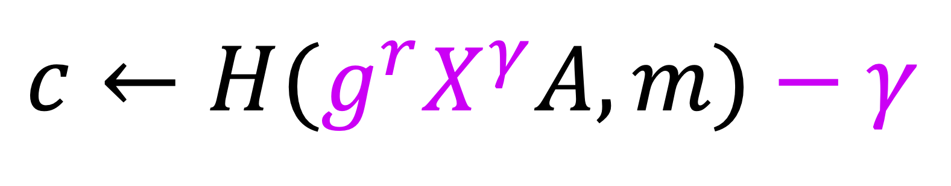

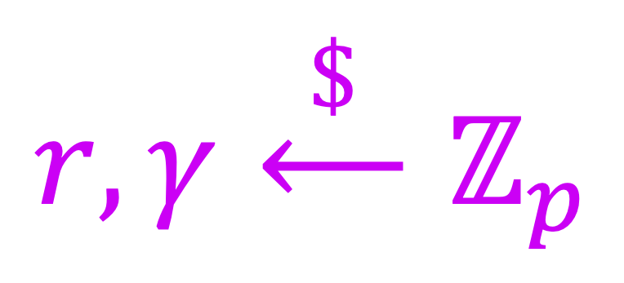
Blind Schnorr
Perfectly Blind
$(𝔾,p,g)$ : $𝔾=⟨g⟩$, $|𝔾|=p$
$H$ : $\{0,1\}^{∗}$ $⟶$ $ℤ_{p}$
$sk$ : $x\overset{\$}{⟵}ℤ_{p}$ , $pk$ : $X←g^{x}$
OMUF
?
Signer: $x$
User: $X$ , $m$
$$A$$
$$r,γ\overset{\$}{⟵}ℤ_{p}$$
$a\overset{\$}{⟵}ℤ_{p}$ , $A←g^{a}$
$$c$$
$c←H(g^{r}X^{γ}A,m)$ $− γ$
$$s←a+c⋅x$$
$$s$$
$σ←(c$ $+ γ,s$ $+ r)$
$\text{Verify}(X,m,σ=(c,s))$:
$A←g^{s}X^{−c}$ ;
Return $c=^{?}H(A,m)$
Notes:
It is easy to get the perfectly blind version of the scheme by adding random masks as highlighted.
Now, let’s look into OMUF of the scheme, where the user becomes the adversary.

Slide 13
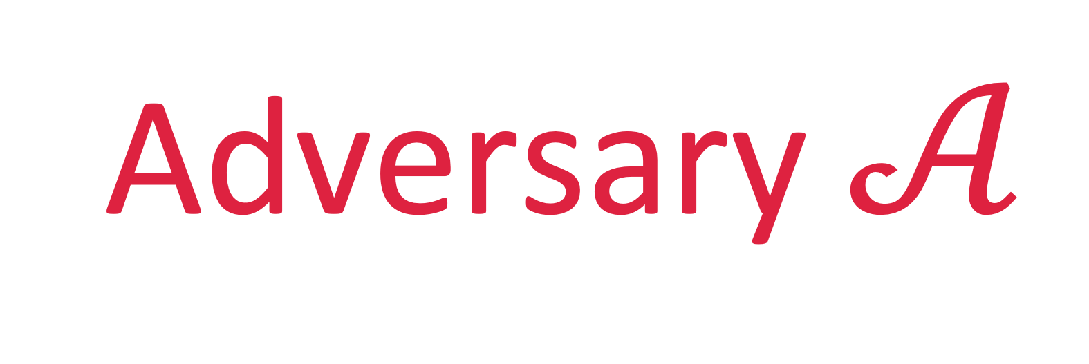
Blind Schnorr
Perfectly Blind
$(𝔾,p,g)$ : $𝔾=⟨g⟩$, $|𝔾|=p$
$H$ : $\{0,1\}^{∗}$ $⟶$ $ℤ_{p}$
$sk$ : $x\overset{\$}{⟵}ℤ_{p}$ , $pk$ : $X←g^{x}$
OMUF
?
Signer: $x$
$$A$$
$a\overset{\$}{⟵}ℤ_{p}$ , $A←g^{a}$
$$c$$
$$s←a+c⋅x$$
$$s$$
Adversary $𝒜$
$\text{Verify}(X,m,σ=(c,s))$:
$A←g^{s}X^{−c}$ ;
Return $c=^{?}H(A,m)$
Notes:
And therefore, we only need to consider the signer’s protocol.

Slide 14
Overview
1.
Blind Schnorr
ROS problem
*Solvable in polynomial time [BLL+21]
2.
3.
Our schemes
GGM or AGM + DL
WFROS problem
*Exponential hardness
Notes:
Now, I will show how to break OMUF of Blind Schnorr by solving the ROS problem.

Slide 15
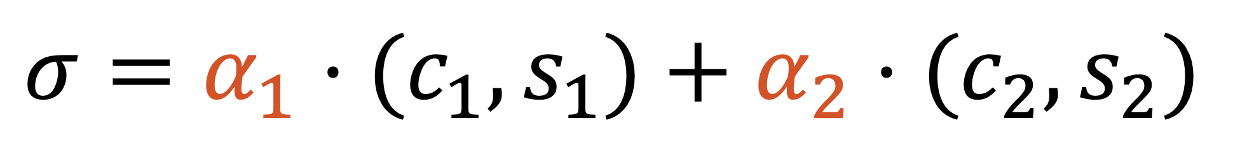
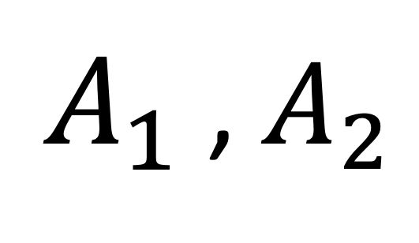
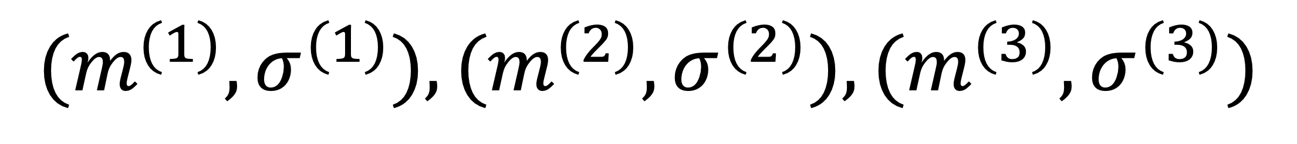
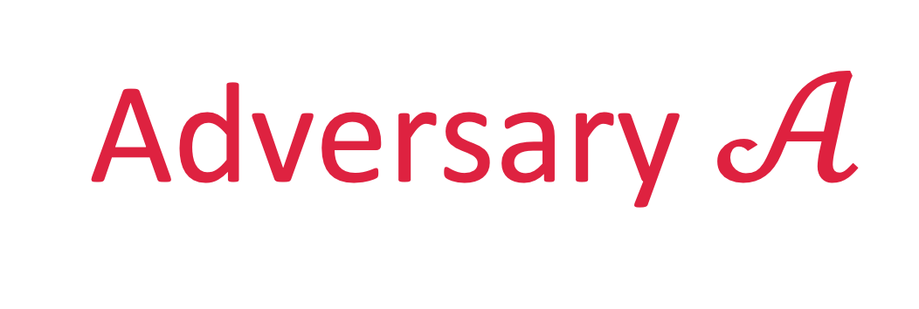
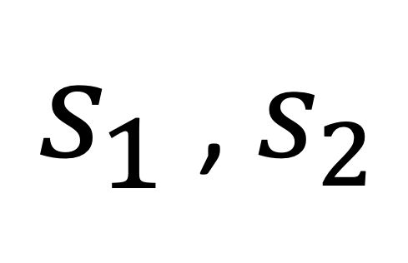
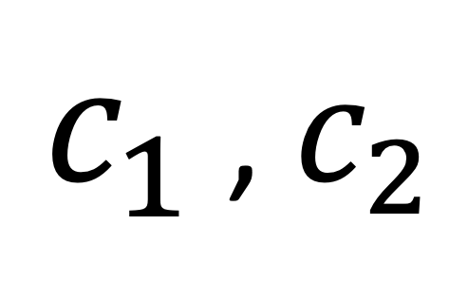
Attack Overview
Signer
$A_{1}$ , $A_{2}$
Adversary $𝒜$
1. Combining two sessions linearly
$c_{1}$ , $c_{2}$
$$σ=α_{1}⋅(c_{1},s_{1})+α_{2}⋅(c_{2},s_{2})$$
$s_{1}$ , $s_{2}$
2. Extend to an attack
$$(m^{(1)},σ^{(1)}),(m^{(2)},σ^{(2)}),(m^{(3)},σ^{(3)})$$
Notes:
Consider an adversary that starts two concurrent signing sessions with the signer. Here I use subscript 1 to denote the first signing session and subscript 2 to denote the second.
Firstly, I will show how to generate a signature that is a linear combination of two sessions.
Then, I will show how to extend it to an attack where the adversary can forge 3 different message signature pairs, and then we will see where the ROS problem appears.

Slide 16
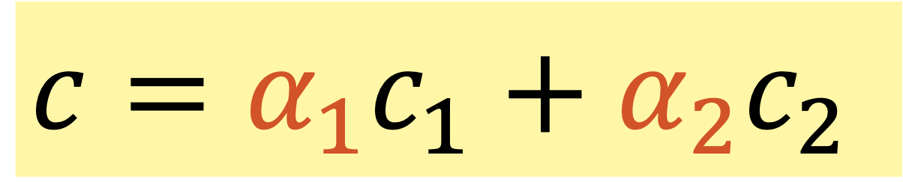

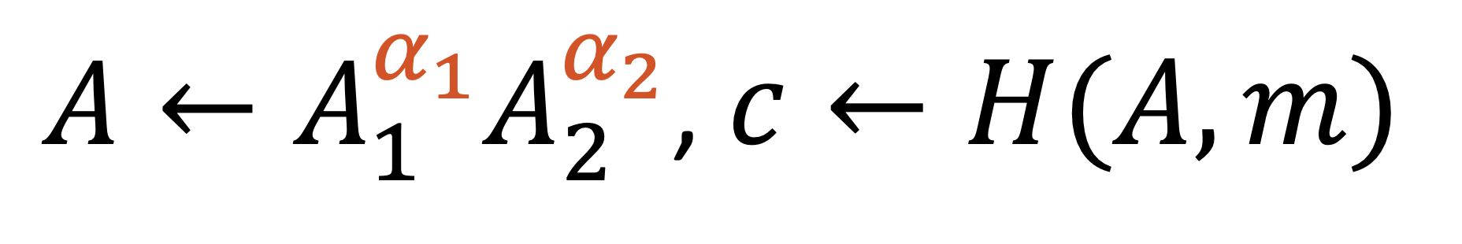
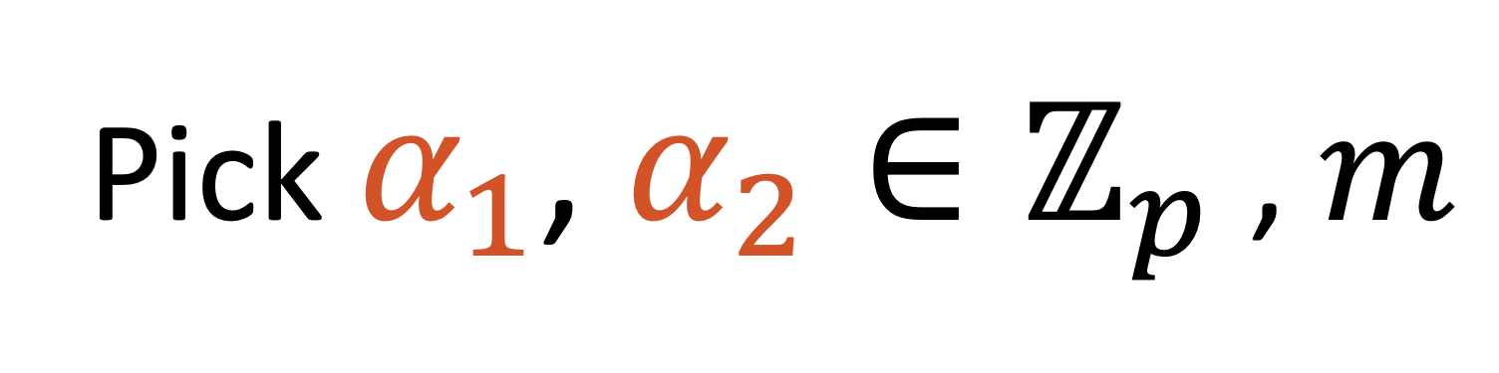
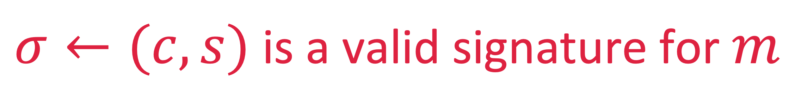
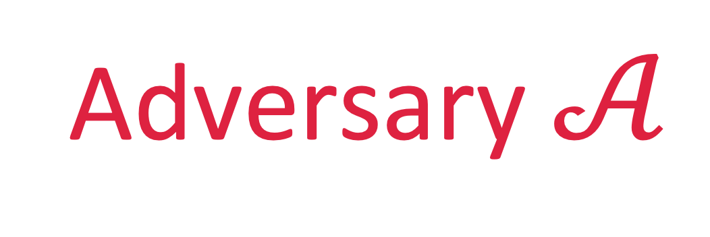
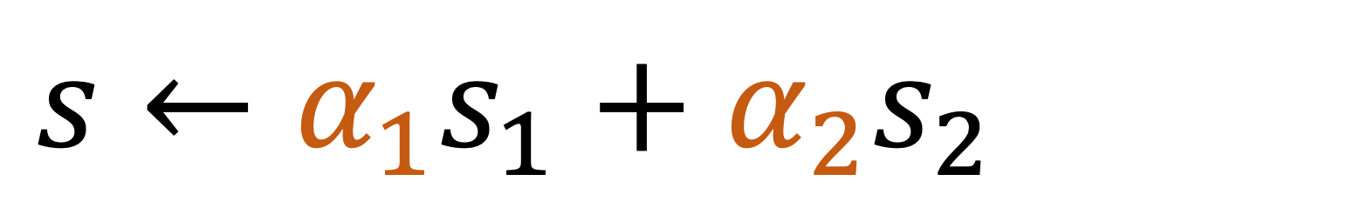
Combining two sessions linearly
Signer
Adversary $𝒜$
$A_{1}$ , $A_{2}$
Pick $α_{1}$, $α_{2}∈ℤ_{p}$ , $m$
$A←A_{1}^{α_{1}}A_{2}^{α_{2}}$, $c←H(A,m)$
$c_{1}$ , $c_{2}$
Pick $c_{1}$, $c_{2}∈ℤ_{p}$ such that
$s_{1}$ , $s_{2}$
$$c=α_{1}c_{1}+α_{2}c_{2}$$
$$s←α_{1}s_{1}+α_{2}s_{2}$$
$σ←(c,s)$ is a valid signature for $m$
Notes:
To combine two sessions linearly, the adversary first picks two linear coefficients alpha1 and alpha2 arbitrarily together with a message, and computes A as … and c as …
Then, the adversary picks c1 and c2 such that c equals to the linear combination of c1 and c2 with coefficient alpha.
Finally, the adversary set s to be the linear combination of s1 and s2. I will now show that (c, s) is a valid signature for m.

Slide 17
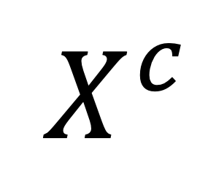
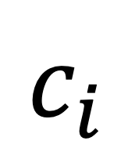













Signer: $x$
$$A_{i}$$
$a_{i}\overset{\$}{⟵}ℤ_{p}$ , $A_{i}←g^{a_{i}}$
$$c_{i}$$
$σ←(c,s)$ is a valid signature for $m$
$$s_{i}←a_{i}+c_{i}⋅x$$
$$s_{i}$$
$$s_{1}=a_{1}+c_{1}⋅x$$
$$s_{2}=a_{2}+c_{2}⋅x$$
$α_{1}s_{1}$ $+$ $α_{2}s_{2}$ $=$ $α_{1}a_{1}$ + $α_{2}a_{2}$ + $(α_{1}c_{1}$ + $α_{2}c_{2})⋅x$
$$A_{1}^{α_{1}}A_{2}^{α_{2}}$$
$$g^{s}$$
$$=$$
$$A$$
$$⋅$$
$$X^{c}$$
Notes:
To see why this is the case, from the signing protocol, we can get these two equations. Then, we combine the two equations with linear coefficients alpha1 and alpha2.
Let’s raise g to values on both sides of the equation.
The left-hand side gives you g^s, the first two terms on the right hand side give you A_1^\alpha_1 A_2^alpha2, which equals to a, and the last term gives you X^c.
This is exactly what we needed for the signature to be valid.

Slide 18




Extend to an attack
Signer
Adversary $𝒜$
$A_{1}$ , $A_{2}$
Pick $α_{1}$, $α_{2}∈ℤ_{p}$ , $m$
$A←A_{1}^{α_{1}}A_{2}^{α_{2}}$, $c←H(A,m)$
$c_{1}$ , $c_{2}$
$s_{1}$ , $s_{2}$
Pick $c_{1}$, $c_{2}∈ℤ_{p}$ such that
$$c=α_{1}c_{1}+α_{2}c_{2}$$
$$s←α_{1}s_{1}+α_{2}s_{2}$$
$σ←(c,s)$ is a valid signature for $m$
Notes:
Now to extend it to an attack, the idea is instead of picking one triple, (alpha1, alpha2 m), we pick three of them, and then picks c1 and c2 such that the highlighted equation holds for all them.

Slide 19




Extend to an attack
Adversary $𝒜$
ROS problem
Signer
$A_{1}$ , $A_{2}$
Pick
${\left\{α_{1}^{(j)},α_{2}^{(j)},m^{(j)}\right\}}_{j∈\{1,2,3\}}$
$$c^{(j)}←H(A_{1}^{α_{1}^{(j)}}A_{2}^{α_{2}^{(j)}},m^{(j)})$$
$c_{1}$ , $c_{2}$
$s_{1}$ , $s_{2}$
Pick $c_{1}$, $c_{2}∈ℤ_{p}$ such that
$$∀ j, c^{(j)}=α_{1}^{(j)}c_{1}+α_{2}^{(j)}c_{2}$$
$σ^{(j)}←α_{1}^{\left(j\right)}⋅\left(c_{1},s_{1}\right)+α_{2}^{\left(j\right)}⋅(c_{2}, s_{1})$ is a valid signature for $m^{(j)}$
Notes:
If succeed, the adversary can get a signature from each triple, and therefore breaks the scheme.
To make the attack work, the main problem is how to pick alpha and c1, c2 such that the highlight equations hold. This exactly is the ROS problem for parameter 2.
However, solving ROS problem for 2 is still hard.

Slide 20









Extend to general $ℓ$
*Solvable when $ℓ>log p$ [BLL+21]
Adversary $𝒜$
ROS problem
Signer
$A_{1}$ , …, $A_{ℓ}$
Pick
${\left\{α_{1}^{(j)}, …,α_{2}^{(j)},m^{(j)}\right\}}_{j∈\{1,2,3\}}$
$$c^{(j)}←H\left(∏{ A}_{i}^{α_{i}^{\left(j\right)}}, m^{(j)}\right)$$
$c_{1}$ , …, $c_{ℓ}$
$s_{1}$ , …, $s_{ℓ}$
Pick $c_{1}$, $c_{2}∈ℤ_{p}$ such that
$∀ j, c^{\left(j\right)}=∑{ α}_{i}^{\left(j\right)}c_{i}$
$σ^{(j)}←∑{ α}_{i}^{\left(j\right)}⋅\left(c_{i},s_{i}\right)$is a valid signature for $m^{(j)}$
Notes:
But, we can extend the attack \ell sessions. And Benhamouda et al. showed that when \ell is larger than log p, the ROS problem can be efficiently solved, which implies that Blind Schnorr is insecure when the number of sessions is larger than log p.

Slide 21
Overview
1.
Blind Schnorr
ROS problem
*Solvable in polynomial time [BLL+21]
2.
3.
Our schemes
GGM or AGM + DL
WFROS problem
*Exponential hardness
Notes:
Now, let’s move to our schemes.

Slide 22







Main Problem with Blind Schnorr
$$s_{1}=a_{1}+c_{1}x$$
$$s_{2}=a_{2}+c_{2}x$$
Any $α_{1}$ , $α_{2}$
$α_{1}s_{1}$ $+$ $α_{2}s_{2}$ $=$ $α_{1}a_{1}$ + $α_{2}a_{2}$ + $(α_{1}c_{1}$ + $α_{2}c_{2})⋅x$
$$s$$
$$c$$
$$σ=$$
$$(c,s)$$
Notes:
Remember that the key step of the ROS attack against Blind Schnorr is that we can linearly combine two sessions to get a valid signature.

Slide 23








Our Idea
$y_{1}$, $y_{2}$ are chosen randomly and hidden to the adversary before picking $c_{1}$ , $c_{2}$
$$s_{1}=a_{1}+c_{1}⋅y_{1}⋅x$$
$$s_{2}=a_{2}+c_{2}⋅y_{2}⋅x$$
Any $α_{1}$ , $α_{2}$
$α_{1}s_{1}$ $+$ $α_{2}s_{2}$ $=$ $α_{1}a_{1}$ + $α_{2}a_{2}$ + $(α_{1}c_{1}$ + $α_{2}c_{2})⋅?⋅x$
$$s$$
$$c$$
$$σ=$$
$$(c,s,?)$$
Notes:
And our idea to add a random y to the equation.
Suppose y1 and y2 are randomly chosen and hidden to the adversary before picking c1 and c2. Then, it is not possible to get a signature which is a linear combinations of two sessions anymore. Basically, we cannot pick a y value to make the equation holds.

Slide 24














Our Scheme 1 (non-blind version)
Signer: $x$
User: $X$ , $m$
$a\overset{\$}{⟵}ℤ_{p}$ , $A←g^{a}$
$A$ , $Y$
$y\overset{\$}{⟵}ℤ_{p}^{∗}$ , $Y←X^{y}$
$$c$$
$$c←H(A,Y,m)$$
$s$ , $y$
$σ←(c,s,y)$
$$s←a+c⋅y⋅x$$
Verify$(X,m,σ=(c,s,y))$:
Reject if $y=0$
Else $A←g^{s}X^{−cy},Y←X^{y}$ ; return $c=^{?}H(A,Y,m)$
*Easy to forge a signature for $y=0$
Notes:
I will now describe how we construct our first scheme with this idea. For simplicity, I will only give a non-blind version. And it is easy to get the perfect blind version from it following common tricks.
The public parameters and key generation parts are exactly the same as Blind Schnorr. In the signing part, the signer additionally samples a non-zero y and sends public key raised to y to the user.
When generating the challenge, the hash also takes Y as input. Then, the signer computes s as a + c * y * x and sends both s and y back. The final signature is now c, s and y.
To verify a signature, we directly reject if y = 0. Otherwise, we recover A and Y from c, s and y, and check whether c is consistent with the hash value.
One thing to notice here is that we do not allow y to be 0 because it is easy to forge a signature for y=0.

Slide 25












Our Scheme 2 (non-blind version)
Signer: $x$
$$Z\overset{\$}{⟵}𝔾$$
User: $X$ , $m$
$a$ , $t\overset{\$}{⟵}ℤ_{p}$ , $A←g^{a}$
$A$ , $Y$
$y\overset{\$}{⟵}ℤ_{p}^{∗}$ , $Y←g^{t}Z^{y}$
$$c$$
$$c←H(A,Y,m)$$
$s$ , $y$ , $t$
$$s←a+c⋅y⋅x$$
$σ←(c,s,y$, $t)$
Verify$((X, Z),m,σ=(c,s,y))$:
Reject if $y=0$
Else $A←g^{s}X^{−cy},Y←g^{t}Z^{y}$ ; return $c=^{?}H(A,Y,m)$
Partially blind: $Z←H_{2}($info$)$
Notes:
For our second scheme, the only difference is that the value of big Y is changed to a Pedersen commitment of little y, where Z is part of the public key.
Since the commitment Y perfectly hides the value of little y, we can relax our assumption from GGM to AGM with DL assumption.
Also, to make the scheme partially blind, we just need to set Z to be a hash of info for each signing, where info represents the part of the message that is known to the signer.

Slide 26







OMUF of scheme 1 to WFROS
Theorem. For any GGM adversary $𝒜$, the probability to break OMUF of scheme 1
$$≤{\text{Adv}}_{Q_{H},ℓ,p}^{\text{wfros}}(\overset{ __}{𝒜})$$
$$+ O\left(\frac{Q_{Φ}^{2}}{p}\right)$$
$${\text{Adv}}_{Scheme 1}^{\text{omuf}}(𝒜)$$
$Q_{H}$: # of $H$ queries
$ℓ$: # of sessions
$Q_{Φ}$: # of group operations
Notes:
Due to the time limit, I will only show the main theorem we get for Scheme 1.
Formally, for any GGM adversary A, the probability to break OMUF of scheme 1 is bounded by the probability of solving the corresponding WFROS problem plu s an extra term
where, Q_h is the number of queries to the hash function H, \ell is the number of signing sessions, and Q_phi is the number of group operations performed by A. So for polynomial time A, the last term in the bound is negligible. Therefore, our scheme is secure as long as it is hard to solve the corresponding WFROS problem.

Slide 27


Hardness of WFROS
Theorem. For any adversary $𝒜$, the probability of solving WFROS
$${\text{Adv}}_{Q_{H},ℓ,p}^{\text{wfros}}(𝒜)≤\frac{Q_{H}(Q_{H}+2ℓ)}{p−1}$$
$$max\{Q_{H},ℓ\}≥Ω(\sqrt{p})$$
Notes:
For the hardness of WFROS, we can show that for any adversary, the probability of solving WFROS is bounded by QH (QH + \2ll) over (p - 1). Here note that p is the original group order.
Intuitively, it implies in order to solve the problem, either Q_H or \ell need to be roughly square root of p. Which implies the exponential security of our scheme.

Slide 28
Overview
1.
Blind Schnorr
ROS problem
*Solvable in polynomial time [BLL+21]
2.
3.
Our schemes
GGM or AGM + DL
WFROS problem
*Exponential hardness
Notes:
For the last part, I will try to convey some ideas behind how WFROS is defined, and why it is hard to solve.

Slide 29




Recall: Main Idea
$$s_{1}=a_{1}+c_{1}⋅y_{1}⋅x$$
$$s_{2}=a_{2}+c_{2}⋅y_{2}⋅x$$
$y_{1}$, $y_{2}$ are chosen randomly and hidden to the adversary before picking $c_{1}$ , $c_{2}$
Any $α_{1}$ , $α_{2}$
$α_{1}s_{1}$ $+$ $α_{2}s_{2}$ $=$ $α_{1}a_{1}$ + $α_{2}a_{2}$ + $(α_{1}c_{1}$ + $α_{2}c_{2})⋅?⋅x$
However, the adversary can use more general strategies to combine sessions …
Notes:
Remember that our main intuition was that in our schemes, we cannot combine two sessions linearly.
However, there are actually other ways to combine two sessions.

Slide 30








Combining two sessions trivially
$$s_{1}=a_{1}+c_{1}⋅y_{1}⋅x$$
$$s_{2}=a_{2}+c_{2}⋅y_{2}⋅x$$
Let $c_{1}=c_{2}=c$
Any $α_{1}$ , $α_{2}$
$α_{1}s_{1}$ $+$ $α_{2}s_{2}$ $=$ $α_{1}a_{1}$ + $α_{2}a_{2}$ + $c⋅(α_{1}y_{1}$ + $α_{2}y_{2})⋅x$
$$s$$
$$y$$
$$σ=$$
$$(c,s,y)$$
Does not help! Both sessions cannot be used for generating other signatures!
Notes:
For example, one trivial way is letting both c1 and c2 equal to c, and then, we can combine the two sessions to get a signature with arbitrary alpha values.
However, this does not help to break the security at all! Both sessions …
Basically, you are using two sessions to generate only one signature.
But, it is still unclear whether the adversary can combine sessions in other ways.

Slide 31
















WFROS problem for $ℓ$
The trivial way is the only way to combine sessions
$α_{1}^{(j)}$, …, $α_{ℓ}^{(j)}$, $β_{1}^{(j)}$, …, $β_{ℓ}^{(j)}$
$$H$$
$$𝒜$$
$$c^{(j)}←ℤ_{p}$$
$$c^{(j)}$$
*Denote # of $H$ queries as $Q_{H}$
$i$, $c_{i}$
$$S$$
$$y_{i}$$
$$y_{i}←ℤ_{p}^{∗}$$
*Exactly once for each $i∈\{1,…,ℓ\}$
$$J:=\left\{j:B^{(j)}≠0,\frac{A^{(j)}}{B^{(j)}}=c^{(j)}\right\}$$
$$A^{(j)}=∑_{i=1}^{ℓ}α_{i}^{(j)}y_{i}c_{i}$$
$$B^{(j)}=∑_{i=1}^{ℓ}β_{i}^{(j)}y_{i}$$
$𝒜$ wins if $|J|≥ℓ+1$
Notes:
Therefore, we define the following WFROS problem to captures all possible way of combining different sessions.
Due to the time limit, I would not go into details here.
And, the reason why WFROS is hard to solve is essentially because the only way to do combinations is the trivial one I showed in the previous slide.

Slide 32
Open Problems
Avoid AGM and GGM
Other applications of WFROS
Notes:
By the end, I would like to mention some open problems.
First of all, all our results are in either GGM or AGM. So one big open problem is whether we can get a Schnorr-style scheme with exponential security only assuming random oracles.
Also, it is interesting to know whether there are other applications of the WFROS problem.

Slide 33
Thank you!
Our Paper : https://eprint.iacr.org/2022/047.pdf
Notes:
That’s all my talk.
Here’s the eprint link to our paper. Thank you for your listening!

